Slide 1
USA Gun Violence Data Analysis

Slide 2
Introduction:
The Gun Violence dataset represents a comprehensive collection of information related to incidents involving firearms in various contexts. This dataset is a valuable resource for understanding the magnitude, patterns, and dynamics of gun-related incidents, including their locations, impact, circumstances, and other related factors. It is instrumental in the domains of public safety, criminal justice, policy formulation, and advocacy, providing crucial insights into the complex issue of gun violence.
At its core, the dataset typically includes details such as the date and time of the incident, the location (city, state, and coordinates), the number of casualties (fatalities and injuries), the type of gun violence event (e.g., mass shooting, suicide, robbery), the involvement of law enforcement, and various contextual details. Additionally, the dataset might encompass information regarding the victims, the suspects, and the firearms used.
Furthermore, the dataset can be leveraged to raise public awareness, educate communities, and drive informed public discourse about gun violence and its implications. Understanding the multifaceted nature of gun violence is essential for fostering a safer society and promoting evidence-driven solutions to mitigate this critical issue. The Gun Violence dataset plays a pivotal role in achieving these objectives and advancing research and policy efforts aimed at reducing the devastating impact of gun violence.

Slide 3
Problem Statements:
1) How many cases have been registered in each state?
2) Can you compare and contrast gun violence incidents between urban (city) and rural (county) regions?
3) Determine whether there is a link among the existence of particular representative and either the severity or frequency of occurrences.
4) Determine whether particular demographics are particularly susceptible or prone to participating in such situations.
5) Determine whether cases using stolen guns differ from those involving legally owned guns.
6) Determine whether certain geographic regions are particularly prone to gun violence.
7) Identify what particular ages are particularly engaged in these types of situations.
8) Find the overall amount of people murdered in each state.
9) Identify which age group plays the biggest part in this violence.
10) In which year did the most cases occur?

Slide 4
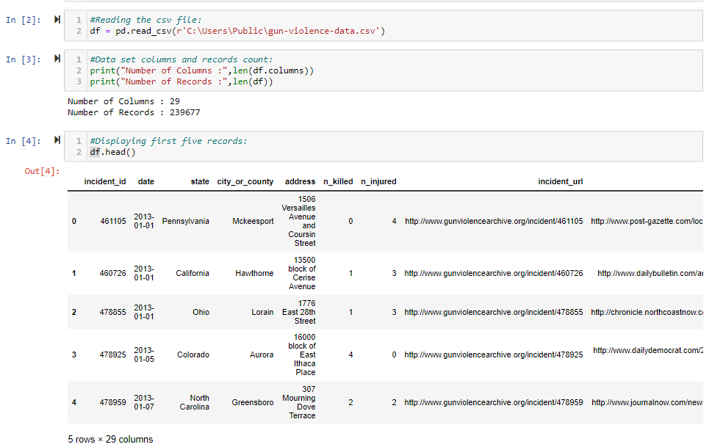
Dataset Details:
This dataset has 29 columns and 239678 records. The dataset enables analysis and investigation of numerous elements of gun violence, such as the frequency and distribution of occurrences, the link with sociodemographic characteristics, the impact on communities, and the efficacy of various preventative and intervention efforts. It provides as a foundation for evidence-based policymaking, assisting legislators, researchers, and activists in developing effective strategies to lessen the negative impacts of gun violence on society.

Slide 5
Dataset Column Details:
incident_id: Unique identifier for each incident.
date: Date of the incident.
state: State where the incident occurred.
city_or_county: City or county where the incident occurred.
address: Address of the incident.
n_killed: Number of people killed in the incident.
n_injured: Number of people injured in the incident.
incident_url: URL related to the incident.
source_url: URL of the information source.
congressional_district: Congressional district where the incident occurred.
gun_stolen: Information about whether the gun used was stolen.
gun_type: Type of gun(s) used in the incident.
incident_characteristics: Characteristics describing the incident.
latitude: Latitude coordinate of the incident location.

Slide 6
location_description: Description of the incident location.
longitude: Longitude coordinate of the incident location.
n_guns_involved: Number of guns involved in the incident.
notes: Additional notes or details about the incident.
participant_age: Age of participants.
participant_age_group: Age group of participants.
participant_gender: Gender of participants.
participant_name: Names of participants.
participant_relationship: Relationship between participants.
participant_status: Status of participants (e.g., victim, suspect).
participant_type: Type of participant (e.g., victim, suspect).
sources: Sources providing information about the incident.
state_house_district: State house district where the incident occurred.
state_senate_district: State senate district where the incident occurred.

Slide 7
Data Pipeline:
Raw Dataset
Preprocessing Data
Data cleaning (Dedup , Junk)
Applied Logic to extract valid data
Visualization

Slide 8
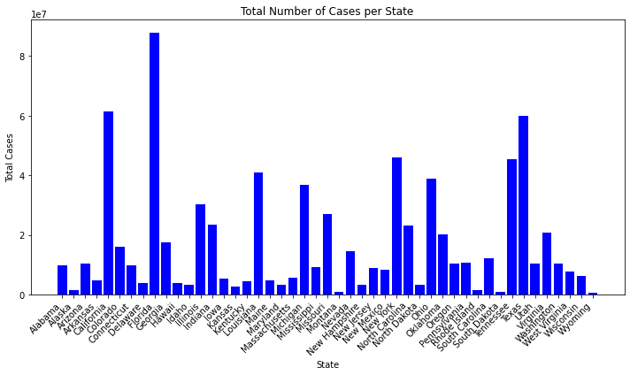
How many cases have been registered in each state?

Slide 9
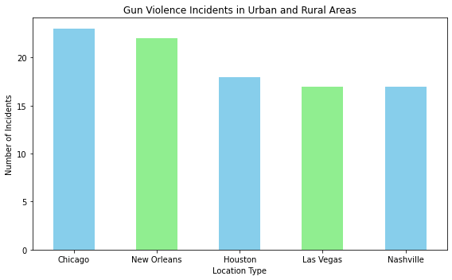
Can you compare gun violence incidents between urban (city) and rural (county) regions?

Slide 10
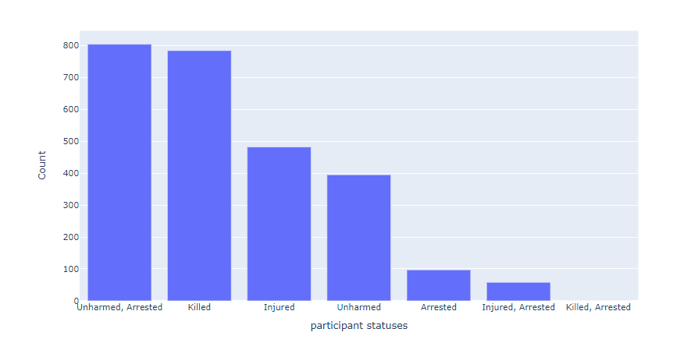
Determine whether there is a link among the existence of particular representative and either the severity or frequency of occurrences.

Slide 11
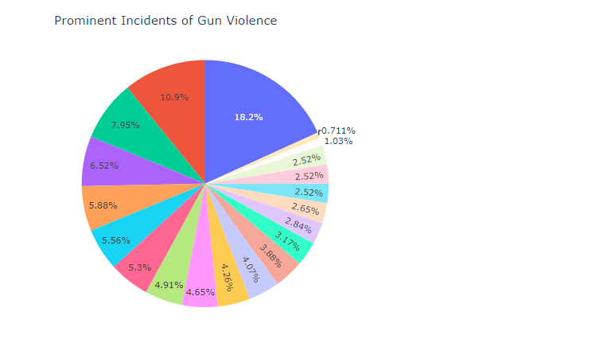
Determine whether particular demographics are particularly susceptible or prone to participating in such situations.

Slide 12
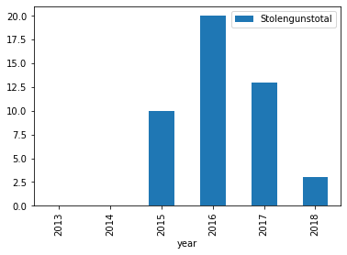
Determine whether cases using stolen guns differ from those involving legally owned guns.

